Slide 1
GHOST Protocol
Greedy Heaviest Observed Subtree

Slide 2
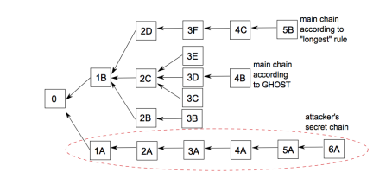

Slide 3
GHOST Algorithm
Assuming the genesis block is the first block mined.
Then, given the i^{th} block, pick the i + 1st block as follows:
• Observe all of Bi’s children (subtrees)
• Choose the heaviest subtree i.e. one with most number of blocks
• The root of this subtree is Bi+1

Slide 4
Advantages of GHOST Protocol
Scalability: GHOST protocol was designed and built with scalability and security in mind so that it can easily handle thousands.
Easy transactions: In a world where cryptocurrency transactions can be completed within seconds from anywhere in the world, GHOST Protocol allows individuals to make transactions with ease through efficient use of computing power.
Freedom to developers: If a developer doesn’t want to take on the responsibility of maintaining their own infrastructure, they can utilize GHOST-powered smart contracts which run on top of it instead.
Saves time and effort: It saves them time and effort. Smart contracts are much quicker and easier than writing applications from scratch. It allows for more people to get involved in the dApp space. This is a great thing for new developers and entrepreneurs to get involved in.

Slide 5
Problems with GHOST
GHOST does not solve all issues. In some cases miners and mining pools can exploit the Bitcoin protocol to gain better rewards than their fair share.
1. Miners better connected to the network gain rewards larger than their fair share.
2. Using the selfish mining strategy, small miners can deliberately add more forks to the network by keeping their blocks created private. This can enable them to create a private chain with a significant lead over the honest public chain.

